Slide 1
OA COURSEWORK PRESENTATION
GROUP NUMBER 08

Slide 2

INTRODUCTION
The Challenge​
Police forces in the United Kingdom use DNA forensic evidence to solve non-priority cases that include burglary incidents. The current method takes too long, requiring 7–14 days to produce DNA test results.
Where It Breaks Down​
The DNA sequencer operates only two times weekly, and each 48-hour run spans its entire duration.​ Due to slow manual logging combined with delayed transport times and restricted laboratory validation periods, more delays accumulate in the process.​
The system performs best for large batch operations rather than achieving fast results.
Why It Matters​
The probability of the arrest for obtaining meaningful intelligence extends from 24 to 48 hours.​ Late results develop into missed chances for suspect arrests and the recovery of stolen goods.​
Objective of This Study​
We will determine how Rapid DNA technology, combined with operational adjustments, can shorten the response time through simulated analysis for selecting cost-effective and optimal solutions.

Slide 3
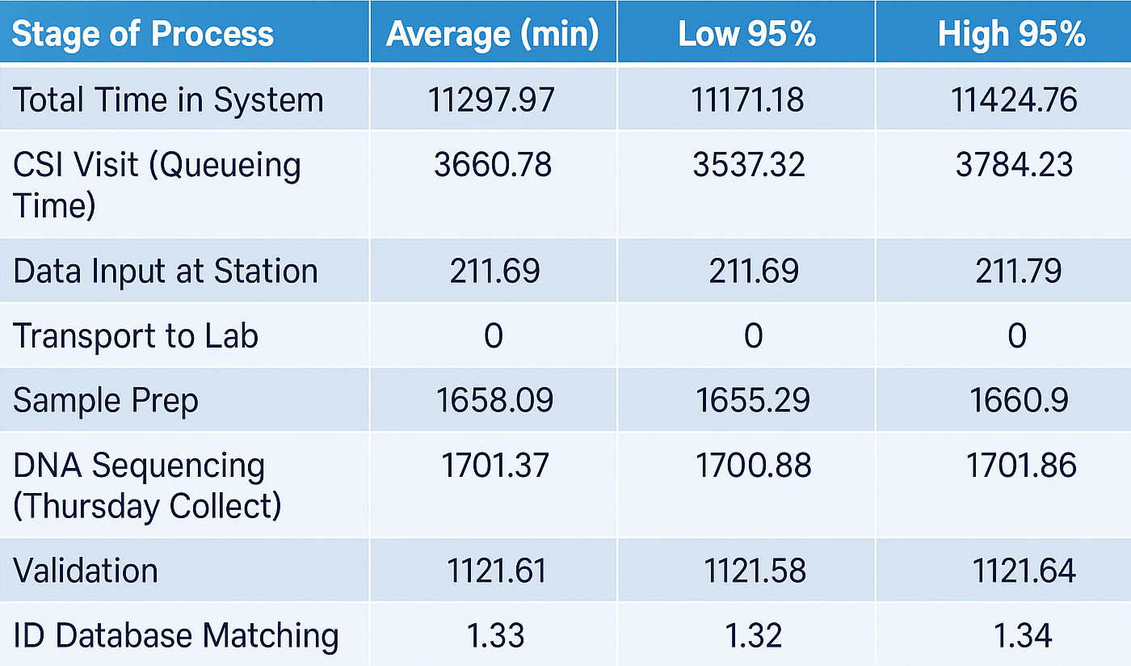
CURRENT DNA FORENSICS PROCESS
CSI only available Monday–Friday, 8AM–3PM; no weekend coverage.
Samples transported to labs once daily, after manual evidence input at stations.
Lab work is also limited; DNA sequencer runs only twice a week in batches.
Samples experience long queueing delays waiting for collection, transport, batching, and validation.
Total processing often exceeds 7–14 days, with very low match rates and almost no samples completed within 48 hours.

Slide 4
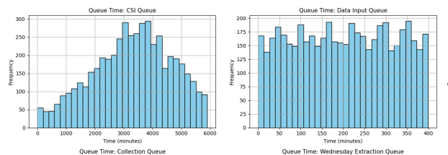
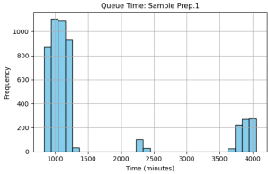
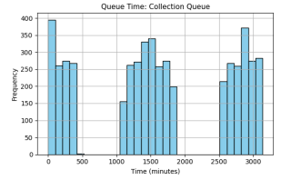
Queueing Time Distributions - Current DNA Process
CSI Queue is the largest delay, with times reaching up to 6000 minutes
Data Input Queue is evenly spread — shows a constant backlog
Sample Prep Queue is bimodal — some processed fast, others delayed significantly
Collection and Extraction Queues also show high congestion and inconsistent flow
Overall, the process suffers from heavy front-end and mid-process queuing
Highlights a need to improve CSI responsiveness, evidence logging, and prep scheduling

Slide 5
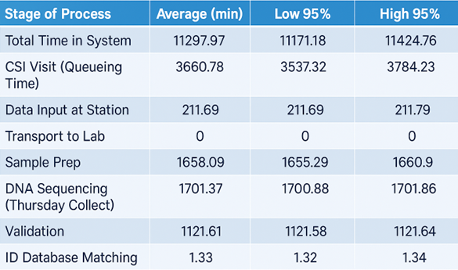
Summary results of current dna process
Total time in system averages 11,298 minutes (~7.8 days), far exceeding the 48-hour target.
0% of samples are processed within 48 hours — no cases meet rapid response needs.
Main delays come from the CSI queue (3,661 mins), sample prep, sequencing, and validation.
Queue times dominate the process: 7,704 mins vs. 3,405 mins of actual activity.
The current system is batch-based, slow, and lacks real-time processing — making it ineffective for fast investigations.

Slide 6
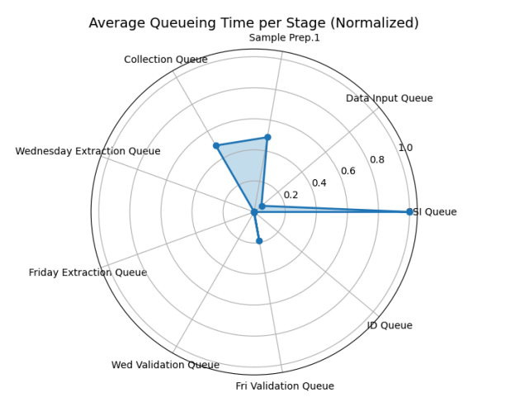
Sensitivity Analysis of CURRENT dna process
CSI Queue has the highest delay (normalized to 1.0) – it’s the main system bottleneck
Collection Queue and Data Input Queue also show notable delays
Lab stages (extraction, validation, ID match) have minimal queue times
Front-end delays dominate the process, not the back-end
Improving CSI availability and evidence logging would have the greatest impact on reducing total system time

Slide 7
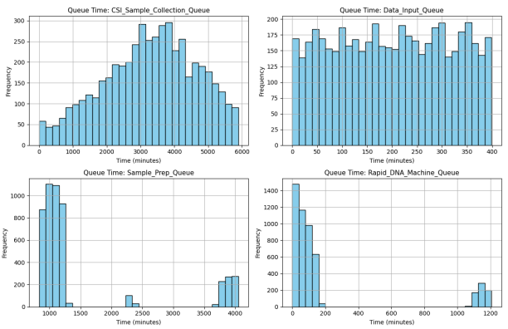
RAPID DNA FORENSICS PROCESS scenario 1:Rapid DNA Only
Long waiting times in most parts of the process
CSI collection queue is very long (up to 6000 mins)
Data input queue shows a steady backlog
Sample prep has uneven delays (some very long)
DNA machine runs fast but still gets delayed at times
Average queue time: 6,467 mins
Only 0.76% of samples processed within 48 hours
Faster machines help, but bottlenecks cause major delays

Slide 8
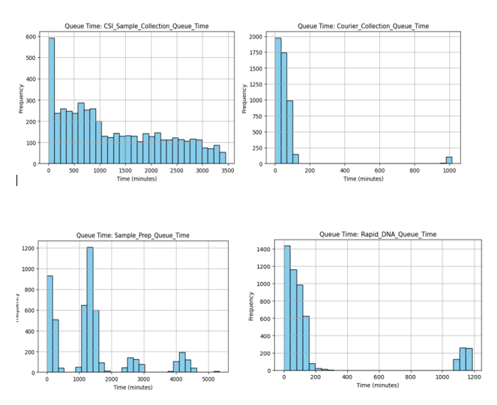
Scenario 2:Rapid DNA + Courier
Courier picks up samples fast → shorter CSI queue
Evidence logged at crime scene using tablet
Courier queue is short → fast transport to lab
Rapid DNA machine runs efficiently
Sample prep still causes delays (some long waits)
Average queue time: 6,467 mins
Only 6.6% completed within 48 hours
40 samples met the 48-hour target
Collection and transport improved, but prep still a bottleneck

Slide 9
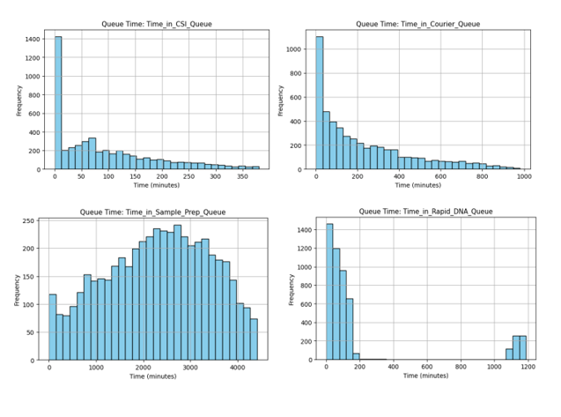
Scenario 3:24 hour CSI visits
CSI now available 24/7 → reduces delays from waiting overnight/weekends
CSI queue times drop sharply – mostly under 100 mins
Courier and DNA machine queues stay short and efficient
Sample prep queue still causes delays (broad, high values)
Average queue time: 3,907 mins
Average total time in system: 4,364 mins
15.92% of samples processed within 48 hours
834 samples met 48-hour target
Major improvement over Scenario 2, but sample prep is still a bottleneck

Slide 10
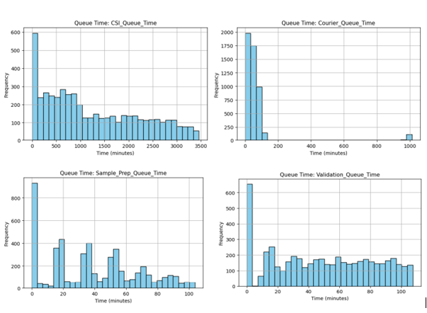
Scenario 4:24 hour CSI lab
Lab runs 24/7 → eliminates delays from limited lab hours
CSI schedule remains Mon–Fri → potential delays in crime scene response on weekends
Sample prep and validation queues significantly reduced due to continuous lab operation
Rapid DNA machine runs more frequently with smoother sample flow
Courier system ensures fast and steady delivery to lab
Back-end (lab) efficiency is maximized, improving overall processing time
Greater percentage of samples processed within 48 hours compared to Scenarios 1–3
Front-end delays (CSI availability on weekends) still limit full system potential

Slide 11
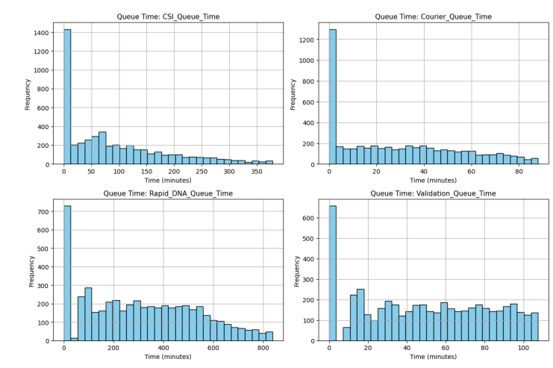
Scenario 5:Complete 24hour operation
CSI teams available 24/7 → no delay in sample collection, even on weekends or nights
Lab operates 24/7 → continuous processing of prep, sequencing, and validation
Courier system still in place for real-time transport from scene to lab
All major queues are short and consistent across stages
End-to-end flow is uninterrupted → system operates around the clock
Eliminates both front-end and back-end delays
Highest percentage of samples processed within 48 hours
Most efficient and responsive setup among all scenarios.

Slide 12
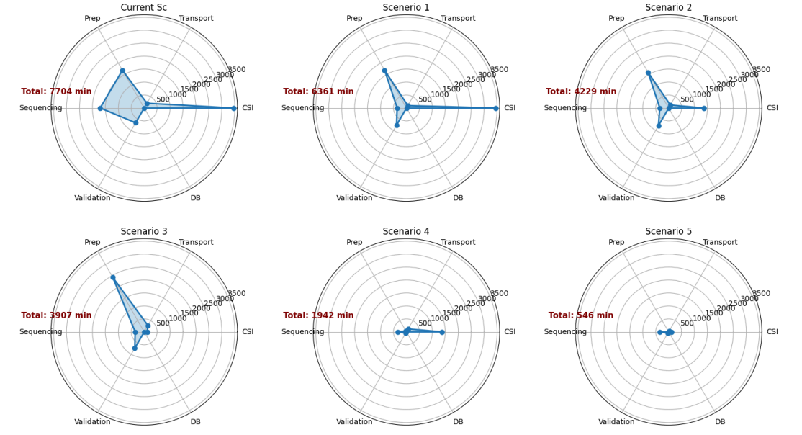
Impact of Process Improvements on Total Queue Times in System
Current: 7704 mins – High CSI & sequencing delays • Scenario 1: 6361 mins – Faster sequencing, CSI still slow • Scenario 2: 4229 mins – Courier cuts CSI delay • Scenario 3: 3907 mins – 24/7 CSI improves collection • Scenario 4: 1942 mins – 24/7 Lab reduces processing delays • Scenario 5: 546 mins – Full 24/7 flow, best performance

Slide 13
Summary results of RAPID dna SCENARIOS
CSI Queue Time improves significantly across scenarios with courier and 24/7 CSI availability
Long waits in Scenario 1 are reduced in later scenarios
Courier Queue remains low and consistent
Ensures timely sample transport in Scenarios 2 through 5
Sample Prep Queue still presents delays, especially in early scenarios
Starts to stabilize in Scenarios 4 and 5 with 24/7 lab coverage
Rapid DNA Machine Queue:
Generally efficient, but occasional delays due to batching
Substantially reduced under full 24/7 operations
Validation Queue drops noticeably in Scenario 5
Continuous lab operation enables quicker post-sequencing checks
✅ Scenarios 4 and 5 show the best overall improvement, minimizing delays across all stages

Slide 14
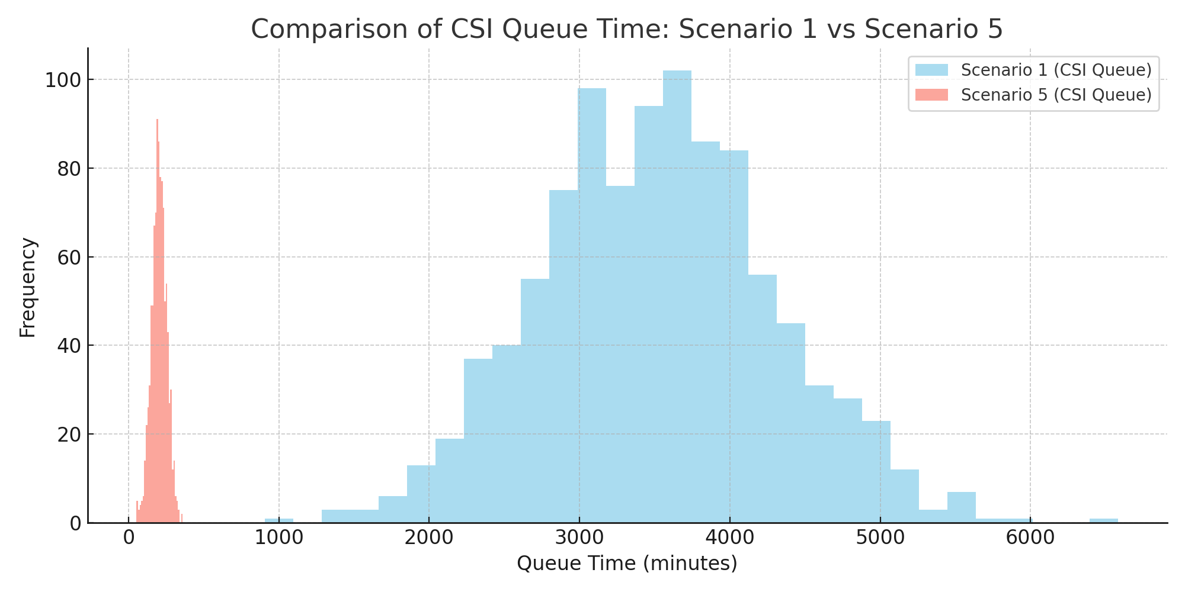
AD-HOC RESULTS OF RAPID DNA SCENARIOS ANALYSIS
CSI Queue
Major delay early on (up to 6000+ mins)
Improved with courier & 24/7 CSI (Scenario 2 & 3)
Sample Prep Queue
High, inconsistent wait times
Reduced with 24/7 lab (Scenario 4 & 5)
Validation Queue
Delayed in daytime-only labs
Clears faster with full-time lab access
Impact of Fixing Bottlenecks:
Faster flow across system
Queue time drops from 7700 mins → 546 mins
% processed in 48h goes from 0% → 15%+

Slide 15
RETURN ON INVESTMENT SLIDE
Scenario | Average Time in System (Minutes) | Cost per Arrest (£ million)
Current Scenario | 10,971 | 2.5
Scenario 1 | 7,211 | 3.12
Scenario 2 | 5,027 | 2.38
Scenario 3 | 4,372 | 2.33
Scenario 4 | 2,584 | 1.43
Scenario 5 | 871 | 1.1
Overall, each scenario progressively reduces system time and cost per arrest, demonstrating clear operational and financial benefits.

Slide 16
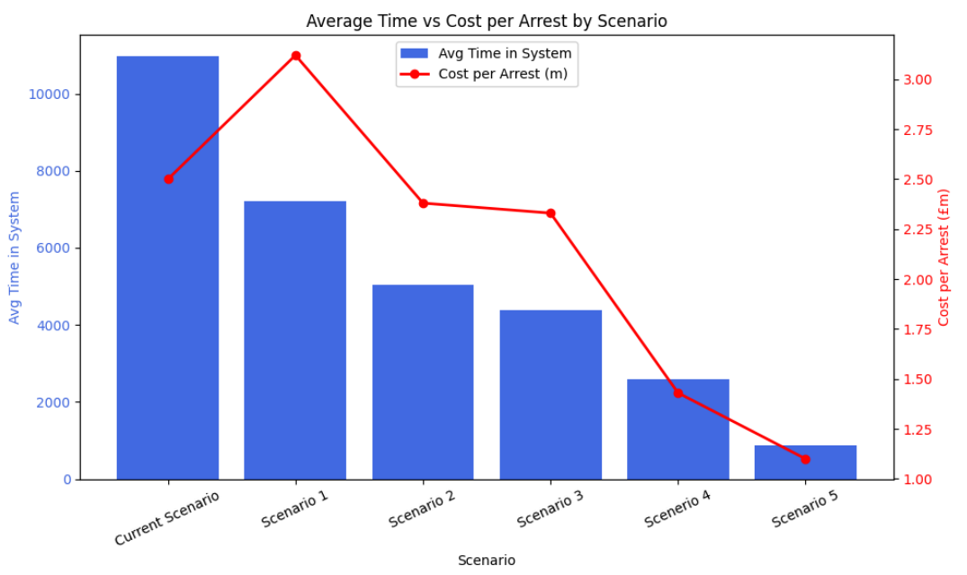
ROI Analysis Time vs Cost per Arrest
🔵 Blue bars show average time in system per scenario
🔴 Red line shows cost per arrest (in £ millions)
Key Takeaways:
Scenario 1 slightly improves time but raises cost per arrest – inefficient upgrade
Scenarios 2 & 3 improve both time and cost moderately
Scenario 4 offers a sharp drop-in time and cost – strong balance
✅ Scenario 5 is the most cost-effective
Fastest turnaround time
Lowest cost per arrest (~£1.2M)
Best return on investment

Slide 17
RECOMMENDATIONS
We recommend implementing Scenario 5 – Rapid DNA + Courier + 24/7 CSI + 24/7 Lab operations.
Why?
Scenario 5 delivers fastest average time in system, highest % of samples processed < 48 hours.
Offers the highest arrest probability due to fast turnaround (based on the golden hour curve).
Although costly (£11M/year), it yields the highest ROI (arrests/£m) when time-to-match is factored in.
Practical Considerations:
Requires hiring for 24/7 CSI and lab coverage — significant operational shift.
May face logistical issues during early implementation (e.g. scheduling, staff availability).
Despite higher upfront cost, the operational benefit justifies investment.

Slide 18
CONCLUSIONS
Simul8 modelling revealed significant delays in the current DNA process, especially around the sequencer and CSI availability.
Scenarios 1–5 progressively reduced total time in the system, with Scenario 5 achieving the fastest turnaround and highest arrest probability.
ROI analysis showed a clear trade-off: higher costs yield better performance and value (Scenario 5 has best arrests per £m).
We recommend Scenario 5 — Rapid DNA + Courier + 24/7 CSI + 24/7 Lab — as the optimal balance of speed, efficiency, and ROI.
This scenario meets operational goals and maximizes policing impact despite the higher investment.

Slide 19
THANK YOU

